Slide 1
Pls 2000 power & politics dr. shannon
REGIME TYPES & DEMOCRACY TYPES

Slide 2
REGIME TYPES & DEMOCRACY TYPES
I. REGIME TYPE
II. TYPES OF DEMOCRACY
TERMS TO KNOW
Democracy (Liberal vs. Illiberal) Presidential System
Competitive Authoritarianism Totalitarian
Parliamentary System Authoritarian
One Party State Universal Suffrage

Slide 3
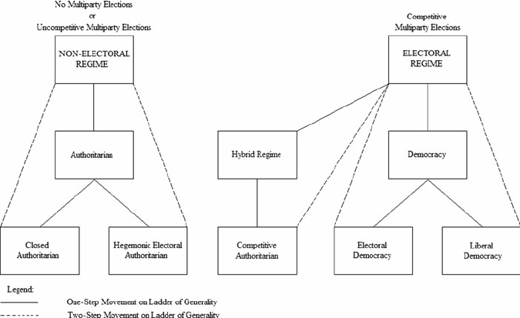
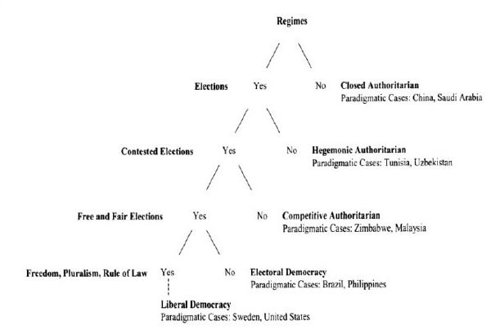
i. REGIME TYPE
Illiberal Democracy
Illiberal Democracy
https://link.springer.com/article/10.1007/s12116-011-9088-x/figures/1
http://news.bbc.co.uk/2/shared/spl/hi/in_depth/china_politics/government/html/1.stm
Notes:
Illiberal democracy is liberal democracy but with less freedom (like you aren’t allowed to defame specific people, or do specific things)

Slide 4
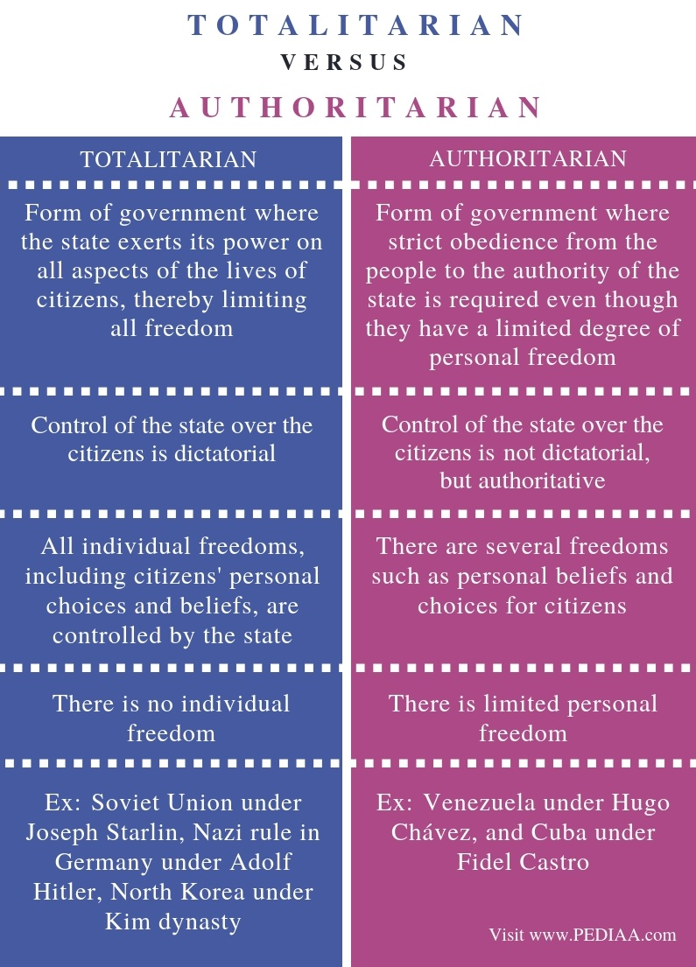
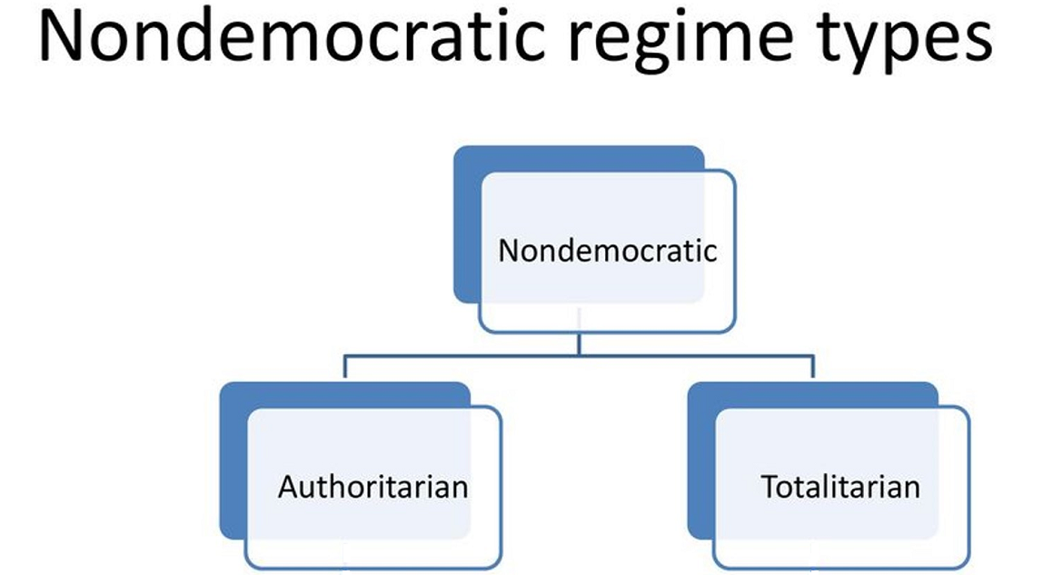
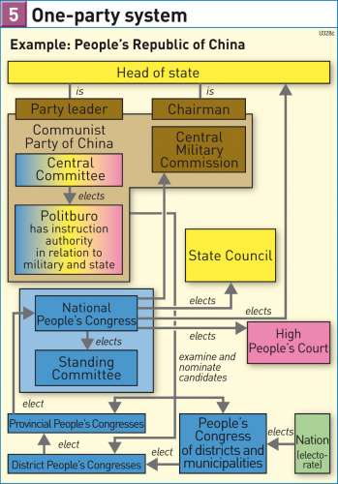
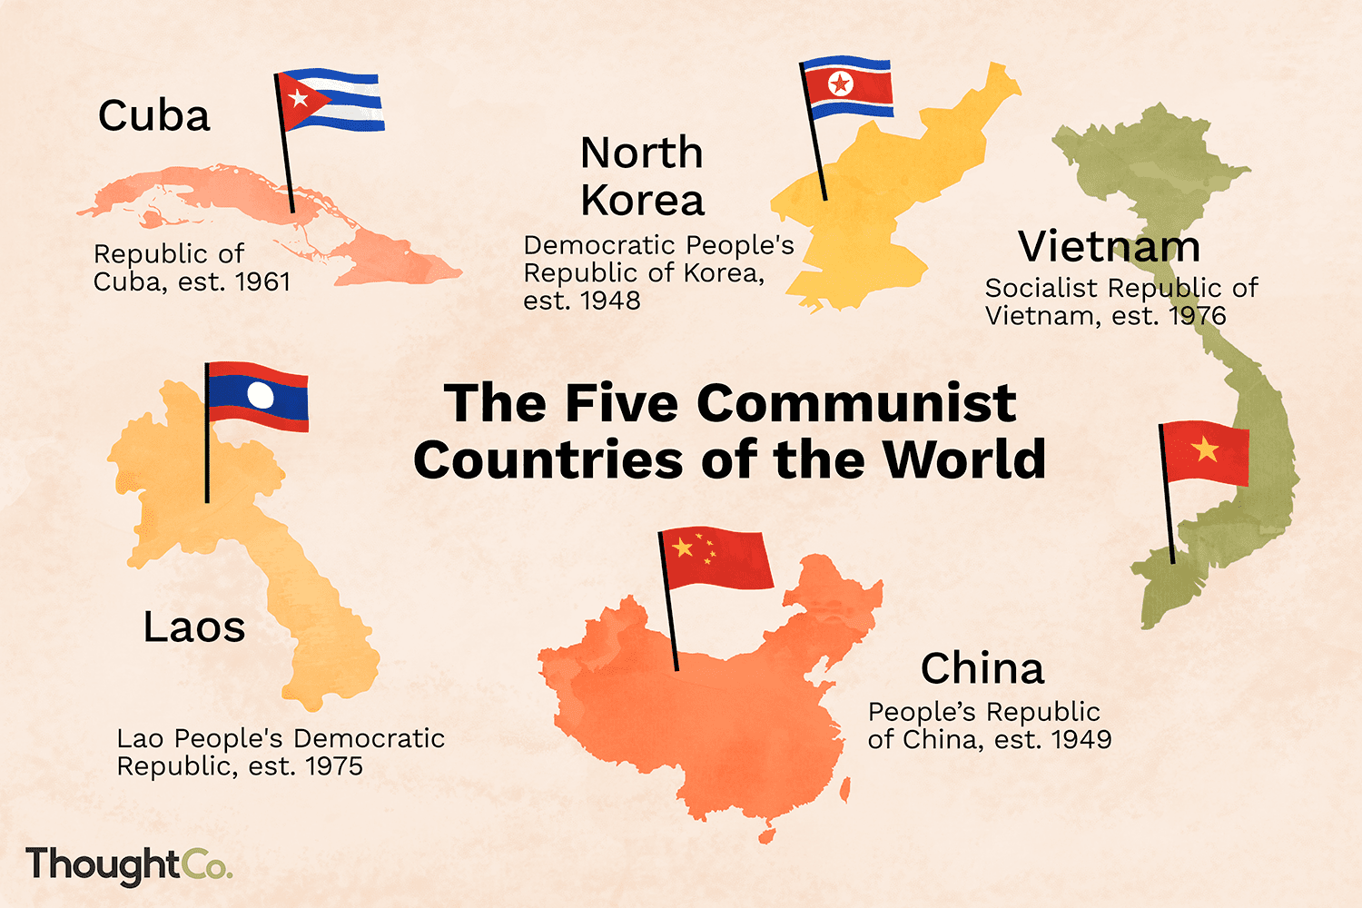
Non-democratic REGIME TYPE
https://www.researchgate.net/figure/Structural-Characteristics-of-Neopatrimonial-Regimes_tbl1_237715188
Notes:
Authoritarian: don’t care about what you do as long as they are in power
Totalitarian: the government has control over everything, no freedoms

Slide 5
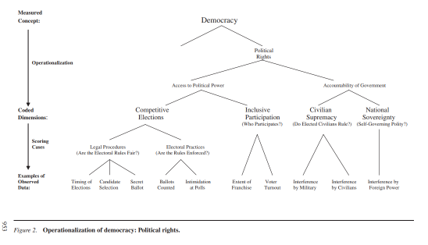
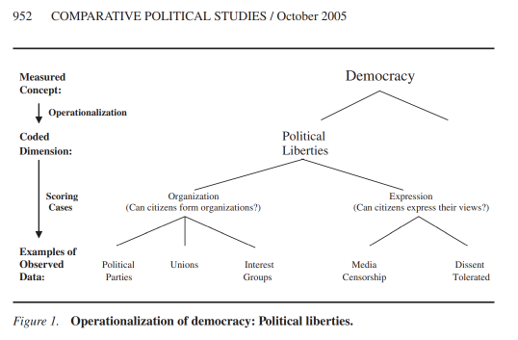
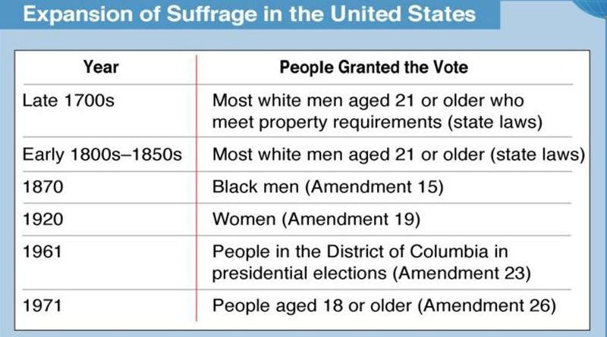
iI. TYPES OF DEMOCRACY
Democracy (p.68)
“rulers act in the interests of the ruled”
“rulers chosen by representatives of the ruled”
“rulers accountable… & removable by the ruled”
Regular, competitive elections
Universal suffrage
Individual rights: Liberal vs. Illiberal Democracy
http://news.bbc.co.uk/2/shared/spl/hi/in_depth/china_politics/government/html/1.stm

Slide 6
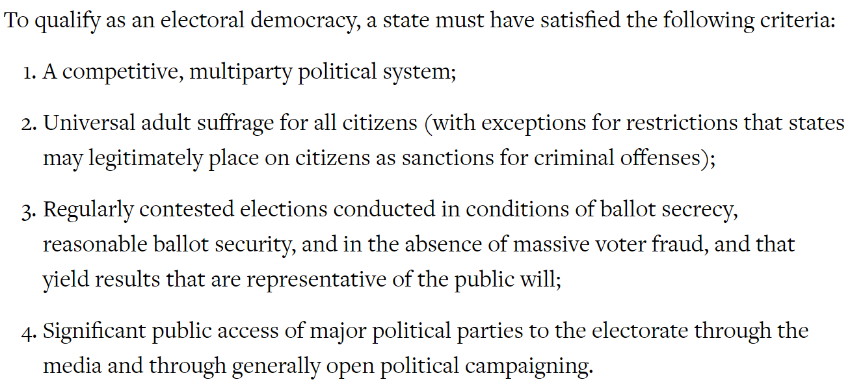
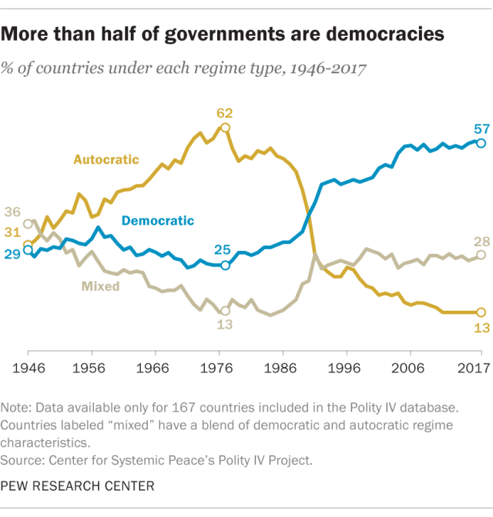
Democratic regimes
https://www.pewresearch.org/fact-tank/2019/05/14/more-than-half-of-countries-are-democratic/
http://news.bbc.co.uk/2/shared/spl/hi/in_depth/china_politics/government/html/1.stm

Slide 7
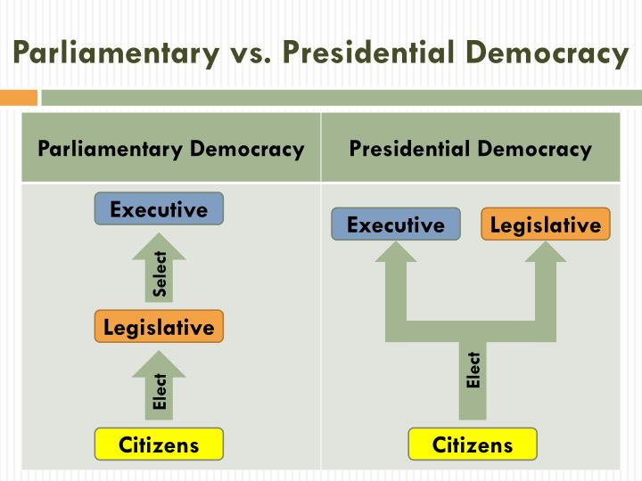
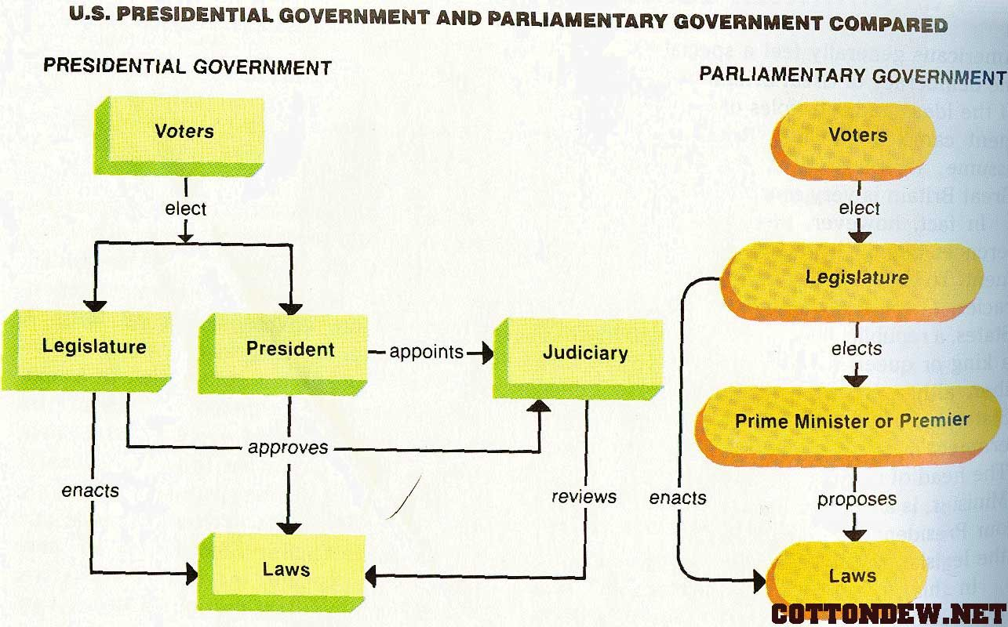
PRESIDENTIAL V. PARLIAMENTARY systems
PRESIDENTIAL: Strong, independent executive
PARLIAMENTARY: Executive comes from Parliament

